Slide 1
WATER QUALITY ANALYSIS USING CONVOLUTIONAL NEURAL NETWORK
PRESENTED BY:
PANDRA SANDEEP KUMAR
III YEAR,KVCET,AI&DS
NM ID:au421221243038
Gmail id:sandeepkumarpandra@gmail.com

Slide 2
PROBLEM STATEMENT:
Water quality significantly impacts human health and environmental sustainability. To maintain water quality, continuous analysis of parameters like pH, hardness, solids, chloramines, sulfate, conductivity, organic carbon, trihalomethanes, turbidity, and portability is crucial. Conventional methods of water quality analysis rely on manual testing, which is both time-consuming and prone to errors, making it labor-intensive.

Slide 3
Why we use CNN for water quality Analysis?
The problem statement revolves around developing an automated system for water quality analysis using Convolutional Neural Networks (CNNs). The goal is to create a model that can accurately classify water samples based on their chemical composition and physical properties. By automating the analysis process, we aim to improve efficiency, reduce costs, and enable timely detection of water quality issues

Slide 4
PROPOSED SYSTEM
Data collection
Import the necessary functions
Data preparation
Splitting of Data
Data processing
Model building
Training the model
Testing the model
Accuracy of the model

Slide 5
SYSTEM APPROACH
SYSTEM REQUIREMENTS:
HARDWARE: Laptop i3 processor with 4gb ram,keyboard,mouse
Software:Anaconda (Jupyter Notebook)

Slide 6
Problem Formulation: The problem involves automating water quality analysis using Convolutional Neural Networks (CNNs). Given a dataset containing water samples with various attributes such as pH, hardness, solids, etc., the objective is to develop a CNN-based model capable of accurately classifying water samples as potable or non-potable based on their chemical composition and physical properties.
Data Exploration:
Dataset collection.
Exploratory data analysis (EDA).
Algorithm Selection and Implementation:
Utilizing Convolutional Neural Networks (CNNs).
Training and validation.
Model evaluation.
Deployment:
Integration into application.
Scalability and reliability.
Continuous improvement.

Slide 7
.
Features Used for Training:
Features used for training include various water quality parameters such as pH, hardness, solids, chloramines, sulfate, conductivity, organic carbon, trihalomethanes, and turbidity.
These features are extracted from the dataset and used as input to the CNN model.
Training Hyperparameters Used:
Epochs:10
Batch size:32
Model Evaluation (Accuracy): 62%

Slide 8
.
Data Preprocessing: Handle missing values, scale features, and encode categorical variables.
Input to Model: Provide preprocessed new data as input to the trained CNN model.
Model Prediction: Obtain the model's prediction for the new data.
Interpretation: Interpret the prediction result to determine the water quality status (potable or non-potable).

Slide 9
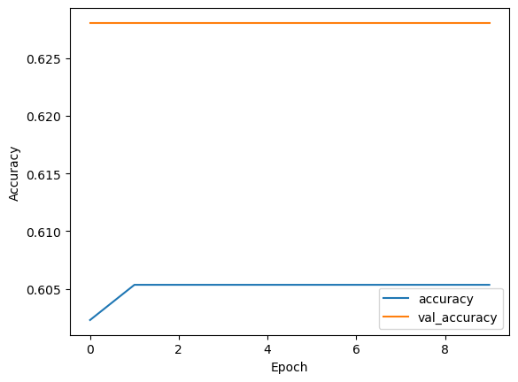
RESULT:
Accuracy :62%
Water is slightly not portable but fit for Domestic use.

Slide 10
CONCLUSION:
The utilization of Convolutional Neural Networks (CNNs) in the water quality analysis project offers a transformative solution to streamline and improve the assessment of water potability. Through the integration of machine learning, especially CNNs, the project targets the inefficiencies inherent in manual testing methods, aiming to mitigate time-consuming processes and reduce the risk of human error. By automating the analysis process, CNNs enhance efficiency and accuracy, paving the way for more reliable and timely evaluations of water quality. This innovative approach holds great promise in advancing the field of water management, ensuring the safety and sustainability of water resources for communities worldwide.

Slide 11
Future works:
Experiment with better CNN designs or try different advanced methods to make the model work even better.
Connect sensors to keep an eye on water quality all the time and get data instantly.
Work together with experts to make easy tools for people to use and understand the results.
Do more tests outside to see how well the model works in different places and situations.

Slide 12
REFERENCE:
Data set:https://www.kaggle.com/datasets/adityakadiwal/water-potability
Libraries(pandas,numpy etc….)
Github:https://www.github.com/water-potability

